Slide 1
What’s new in fireware 12.11

Slide 2
What’s new in Fireware v12.11
Firebox Authentication with SAML
FIPS 140-3 Support
Internet Watch Foundation WebBlocker Category Update
Minimum TLS Protocol Version
Device Information in Local Web UI (Cloud-Managed)
Configuration Report Enhancements
Web Setup Wizard Enhancements
Threat Telemetry Collection
Removal of Mobile VPN with SSL Client Download Page
AP Compatibility for Gateway Wireless Controller
Removal of Obsolete Pop-Up Notification Option

Slide 3
What’s new in Fireware v12.11
Block Failed Logins Default
AuthPoint Support for Block Failed Logins

Slide 4
What’s new in Fireware v12.11
Fireware v12.11 is available for these Firebox models:
Firebox M Series: M270, M290, M370, M390, M470, M570, M590, M670, M690, M4600, M4800, M5600, M5800
Firebox T Series: T20, T25, T40, T45, T55, T70, T80, T85
Firebox NV5
FireboxV and Firebox Cloud
Fireware v12.11 does not support these models:
Firebox T15 and Firebox T35
We continue to support these models with Fireware v12.5.x firmware. For more information, see this KB article

Slide 5
Firebox Authentication with SAML

Slide 6
Firebox Authentication with SAML
With this feature, you can integrate a Firebox with a SAML Identity Provider (IdP) , such as Microsoft Entra ID (formerly Azure AD), and use single sign-on (SSO) and SAML for Firebox user authentication
You can exchange data between an IdP and a Service Provider (SP)
In the SAML configuration on the Firebox, you configure the Firebox as the SP
You can configure SSO and SAML to authenticate with Access Portal, the Firebox Authentication Portal, and Mobile VPN with SSL
The Mobile VPN with SSL v12.11 client for Windows supports SAML authentication. Mobile VPN with SSL for macOS and third-party OpenVPN clients are not supported
SAML authentication is disabled by default
SAML authentication diagnostic log messages use the samld identifier
You can configure a SAML authentication server from WSM, Fireware Web UI, WatchGuard Cloud, and the CLI

Slide 7
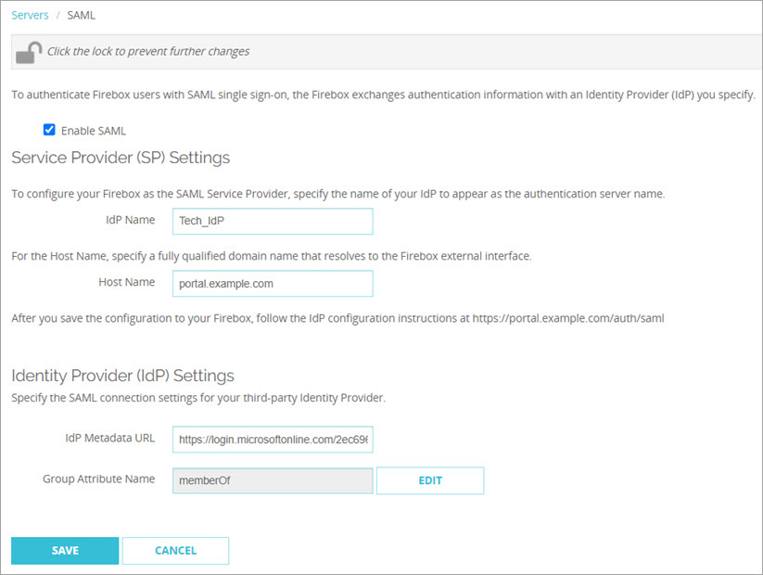
Firebox Authentication with SAML (Fireware Web UI)
To configure a SAML authentication server, from Fireware Web UI:
Select Authentication > Servers > SAML
In the IdP Name text box, type the name of your IdP
In the Host Name text box, type an FQDN that resolves to the Firebox external interface
Keep the IdP Metadata URL text box blank for now Complete the steps in the next section to get the IdP Metadata URL from your IdP administrator
Click Save The Firebox generates a page that includes additional SAML configuration information. Give this information to your IdP administrator

Slide 8
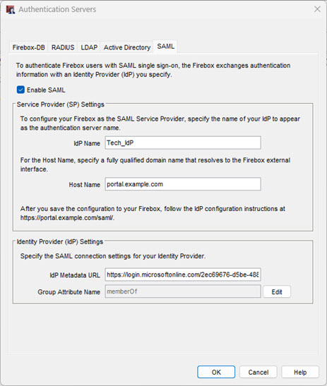
Firebox Authentication with SAML (Policy Manager)
To configure a SAML authentication server, from Policy Manager:
Select Setup > Authentication > Authentication Servers
Select the SAML tab, then select Enable SAML
In the IdP Name text box, type the name of your IdP
In the Host Name text box, type an FQDN that resolves to the Firebox external interface
Keep the IdP Metadata URL text box blank for now Complete the steps in the next section to get the IdP Metadata URL from your IdP administrator
Click OK The Firebox generates a page that includes additional SAML configuration information. Give this information to your IdP administrator

Slide 9
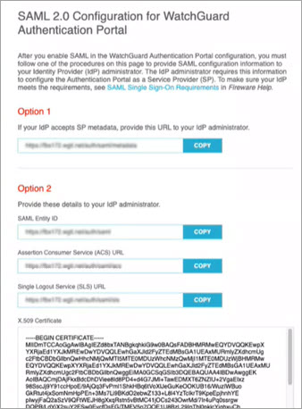
Firebox Authentication with SAML
Your IdP administrator uses information from the SAML configuration page on the Firebox to configure your company account on the IdP website
To connect to the Firebox SAML configuration page:
Go to https://[Host name or IP address for Firebox SAML]/auth/saml
Your IdP administrator must enter the metadata URL from Option 1, or the URLs and certificate from Option 2, to the account settings for your company on the IdP website
The IdP administrator must give you the IdP Metadata URL
Return to the Firebox SAML configuration and type the IdP Metadata URL

Slide 10
Firebox Authentication with SAML (WatchGuard Cloud)
With this feature, you can use a Security Assertion Markup Language (SAML) authentication domain to authenticate users with your cloud-managed Firebox
You can use a cloud-managed Firebox and SAML to authenticate with:
Authentication Portal
Mobile VPN with SSL
With SAML, you can exchange data between an identity provider (IdP) and a service provider
In the SAML configuration on the Firebox, you configure the Firebox as the Service Provider (SP) and a third-party service as the IdP

Slide 11
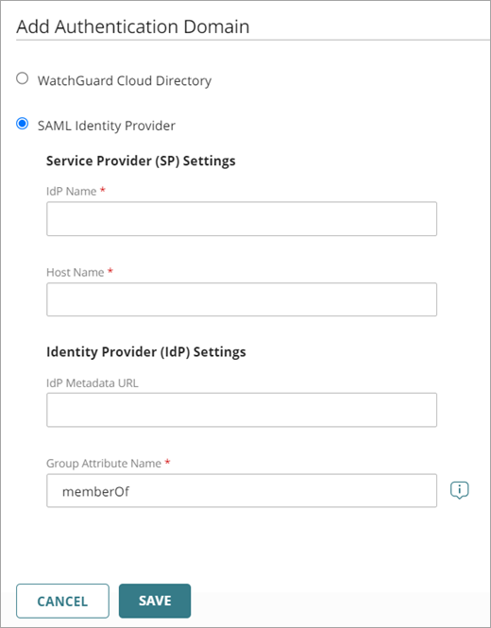
Firebox Authentication with SAML (WatchGuard Cloud)
To configure a SAML authentication server, from WatchGuard Cloud:
Select Add Authentication Domain > SAML Identity Provider
In the IdP Name text box, type the name of your IdP
In the Host Name text box, type an FQDN that resolves to the Firebox external interface
Keep the IdP Metadata URL text box blank for now Complete the steps in the next section to get the IdP Metadata URL from your IdP administrator
Click Save The Firebox generates a page that includes additional SAML configuration information. Give this information to your IdP administrator

Slide 12
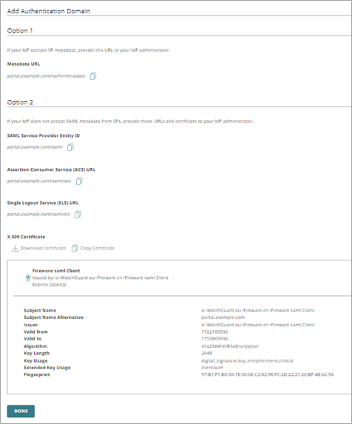
Firebox Authentication with SAML (WatchGuard Cloud)
Your IdP administrator uses information from the generated SAML configuration page to configure your company account on the IdP website
To complete the configuration of the SAML settings:
Your IdP administrator must enter the metadata URL from Option 1, or the URLs and certificate from Option 2, to the account settings for your company on the IdP website
The IdP administrator must give you the IdP Metadata URL
Return to the Firebox SAML configuration and type the IdP Metadata URL. Click Save

Slide 13
Firebox Authentication with SAML (CLI)
To configure a SAML authentication server to authenticate users with your Firebox, from the CLI, enter:
auth-server SAML (enable|hostname|metadata-url|group-attr-name|new-idp-name)
enable — Enable the SAML feature
hostname — Specify a fully qualified domain name that resolves to the Firebox external interface
metadata-url — Identity provider metadata URL
group-attr-name — Group attribute name. The default value is memberOf
new-idp-name — Configures a new IdP name to replace the current IdP name

Slide 14
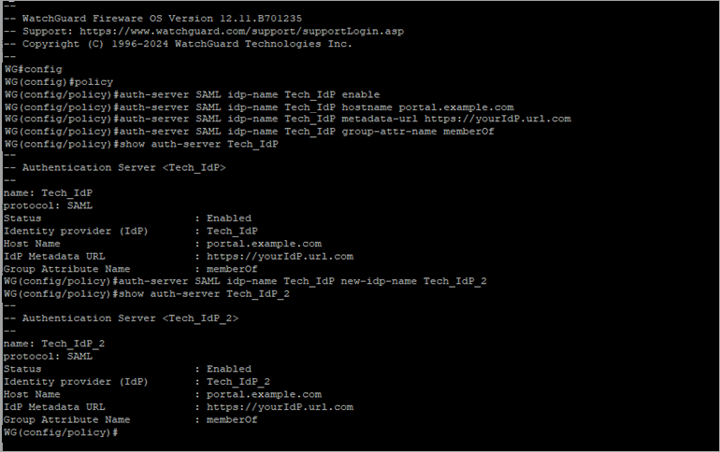
Firebox Authentication with SAML (CLI)
To configure a SAML authentication server, from the CLI, enter:

Slide 15
FIPS 140-3 Support

Slide 16
FIPS 140-3 Support
The Federal Information Processing Standards (FIPS) publication 140-3, “Security Requirements for Cryptographic Modules”, describes the United States Federal Government requirements for cryptographic modules
The Firebox is designed to meet the overall requirements for FIPS 140-3 Level 2 security when configured in a FIPS-compliant manner with Fireware v12.11 (Product Certification status)
These hardware models support FIPS:
WatchGuard Firebox T Series: T20, T20-W, T40, T40-W, T80, NV5, T25, T25-W, T45, T45-PoE, T45-W-PoE, T45-CW, T85-PoE
WatchGuard Firebox M Series: M290, M390, M590, M690, M4800, M5800
FIPS mode is enabled from the Fireware Command Line Interface (CLI)
For more information, go to FIPS Support in Fireware in Help Center

Slide 17
Internet Watch Foundation WebBlocker Category Update

Slide 18
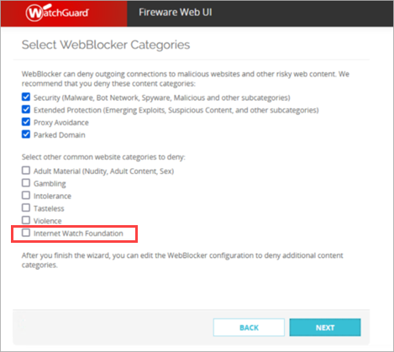
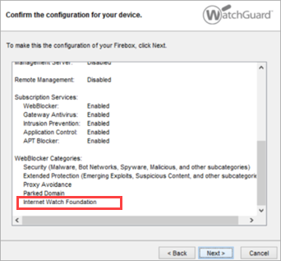
Internet Watch Foundation WebBlocker Category Update
The Internet Watch Foundation (IWF) WebBlocker category is now included in setup wizards and the default WebBlocker action
IWF is a standalone category introduced in Fireware v12.10.2
Content in this category does not fall under any other parent category, and must be blocked separately in new configurations

Slide 19
Minimum TLS Protocol Version

Slide 20
Minimum TLS Protocol Version
In Fireware v12.11 and higher, in new TLS profile configurations, the minimum supported TLS protocol version is TLS v1.2
When you upgrade to Fireware v12.11, existing TLS profile configurations that use lower minimum TLS protocol versions automatically update to TLS v1.2

Slide 21
Device Information in Local Web UI (Cloud-Managed)

Slide 22
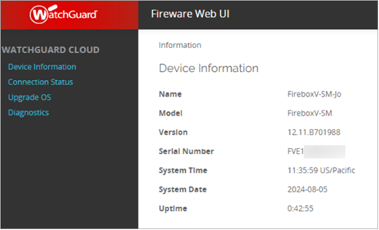
Device Information Page in Fireware Web UI (Cloud-Managed)
For a cloud-managed Firebox, the local Fireware Web UI now includes a Device Information page that shows system information
Information includes the Firebox name, model, Fireware version, serial number, system time, system date, and uptime

Slide 23
Configuration Report Enhancements

Slide 24
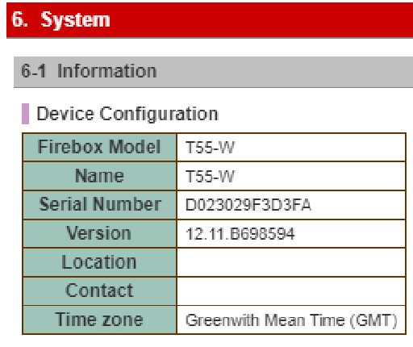
Configuration Report Enhancements
You can now view this information in the Firebox Configuration Report:
Firebox serial number
Fireware version number
Geolocation exceptions

Slide 25
Web Setup Wizard Enhancements

Slide 26
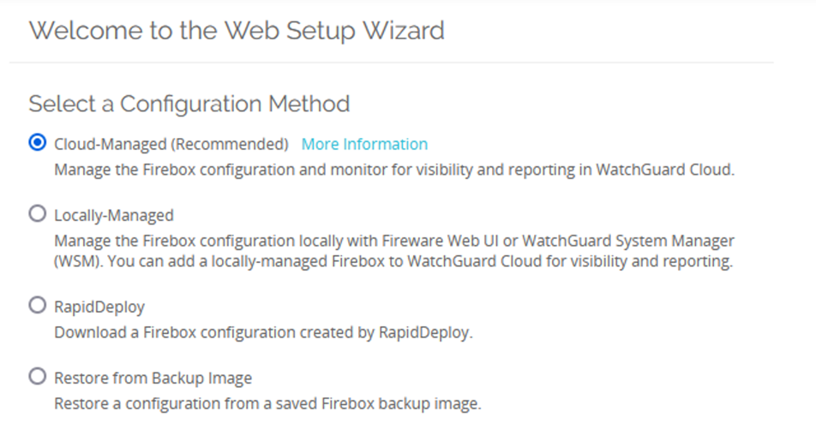
Web Setup Wizard Enhancements
The Web Setup Wizard is now optimized to recommend Firebox management by WatchGuard Cloud

Slide 27
Threat Telemetry Collection

Slide 28
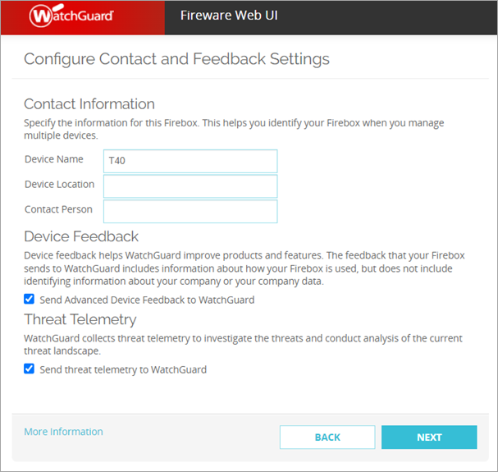
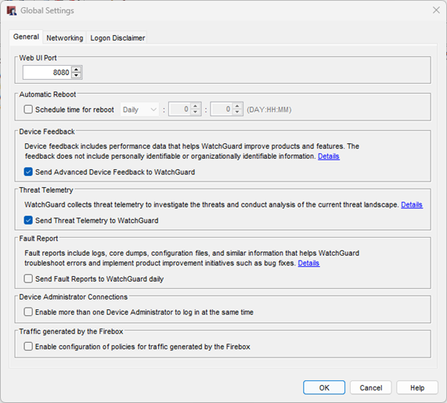
Threat Telemetry Collection
This release adds an option to send threat telemetry information to WatchGuard
The feature is enabled by default

Slide 29
Removal of Mobile VPN with SSL Client Download Page

Slide 30
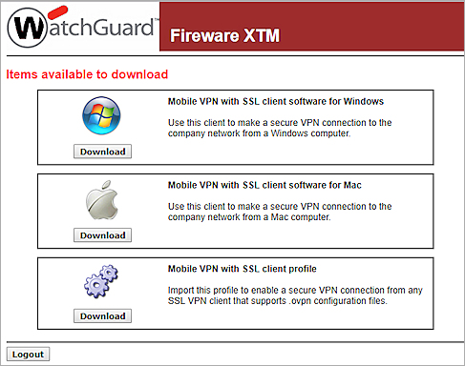
Removal of Mobile VPN with SSL Client Download Page
In Fireware v12.11, the Mobile VPN with SSL client download page is removed from the Firebox
This page was located at: https://<IP address of a Firebox interface or host name>/sslvpn.html
The Mobile VPN with SSL client no longer prompts users when a client update is available
To download the client software, go to https://software.watchguard.com/

Slide 31
AP Compatibility for Gateway Wireless Controller

Slide 32
AP Compatibility for Gateway Wireless Controller
As of Fireware v12.11 and higher:
Only AP125, AP225W, AP325, AP327X, AP420 devices that run the latest v11.0.0-36-4 firmware are supported by the Gateway Wireless Controller on a Firebox
Make sure you upgrade your access points to the latest firmware version before you upgrade to Fireware v12.11
AP100, AP102, AP120, AP200, AP300, AP320, and AP322 devices are no longer supported and cannot be managed with the Gateway Wireless Controller on a Firebox
Devices will still operate with their last known configuration, but can no longer be updated from the Gateway Wireless Controller
The Send Log Messages to Syslog Server option for legacy access points is deprecated and removed

Slide 33
Removal of Obsolete Pop-Up Notification Option

Slide 34
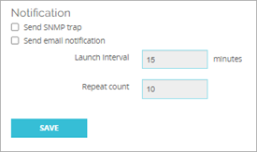
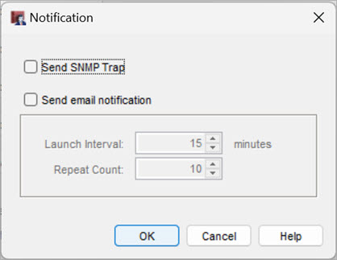
Removal of Obsolete Pop-Up Notification Option
The obsolete pop-up notification option is now removed from logging and notification preferences throughout Fireware Web UI and Policy Manager

Slide 35
Block Failed Logins Default
Block Failed Login
Block Failed Login
Block Failed Login

Slide 36
Block Failed Logins Enabled by Default
The Block Failed Logins feature helps prevent brute force attacks against the login pages of a Firebox
In Fireware v12.11 and higher, the Block Failed Logins feature is enabled by default in new and upgraded configurations, unless you previously configured authentication settings in Fireware v12.10.4
For example:
When you create a new configuration in v12.11, or upgrade from v12.10.3 or lower to v12.11, the feature is enabled by default
When you upgrade from v12.10.4 to v12.11:
If you did not save changes to authentication settings in v12.10.4, the upgrade enables this feature
If you did save changes to authentication settings in v12.10.4, the upgrade does not change your configuration of this feature

Slide 37
aUTHpOINT Support for Block Failed Logins
Block Failed Login
Block Failed Login
Block Failed Login

Slide 38
AuthPonit Support for Block Failed Logins
In Fireware v12.11 and higher, the Block Failed Logins feature now blocks failed login attempts from AuthPoint users

