Slide 1
Introduction to Aether 16
Endpoint Security – Friends & Family
Updated: 25 July 2024

Slide 2
Introduction
The images in this presentation show updates to WatchGuard Endpoint Security (Advanced EPDR, EPDR, EDR, and EPP)
The changes described also apply to:
  Adaptive Defense / Adaptive Defense 360
  Endpoint Protection / Endpoint Protection Plus
This presentation does not describe:
  Changes before Aether 16
  Panda Partner Center or Aether for Partners
  Cytomic products
  Some minor bug fixes
For a complete list of enhancements and resolved issues, go to the Release Notes
  Adaptive Defense 360 Release Notes

Slide 3
Aether 16 Update
This update includes:
  Endpoint Access Enforcement
  Advanced Scanning with AMSI
  Block Vulnerable Drivers
  SHA-256 Support
  Risk Exclusion Management
  Verbose Mode
  Vulnerability Assessment in EDR Core
  Network Access Enforcement for Android Devices
  macOS and Linux Updates

Slide 4
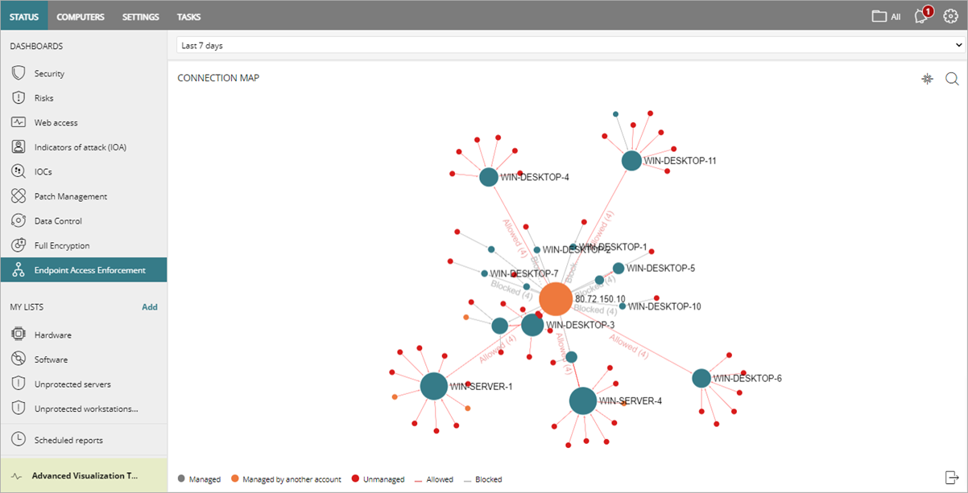
Endpoint Access Enforcement
Endpoint Access Enforcement enables you to monitor and block (Advanced EPDR only) the connections to Windows computers in your network to reduce infections from unprotected devices (Windows, macOS, and Linux)

Slide 5
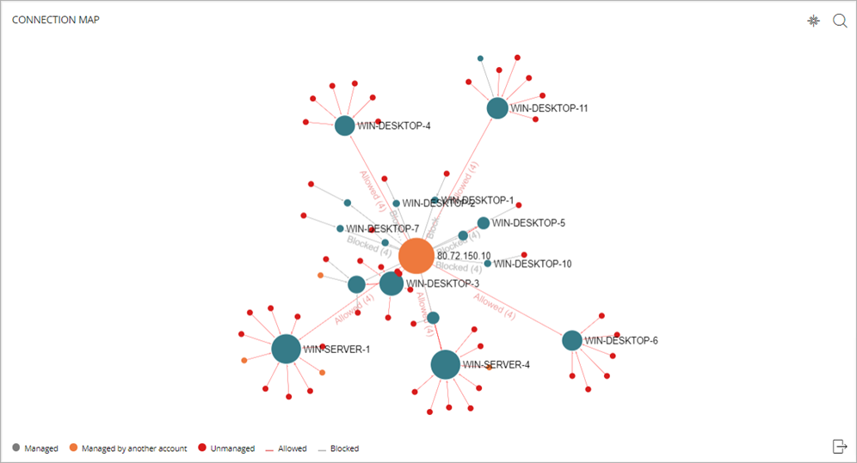
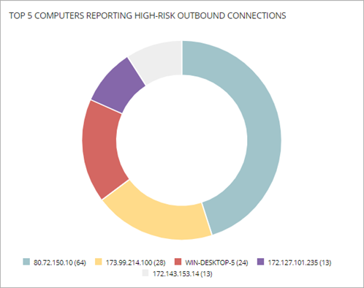
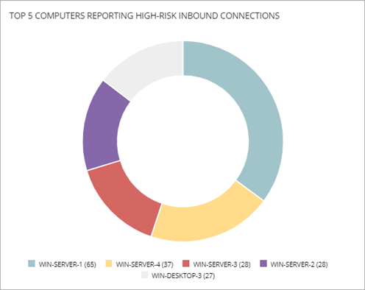
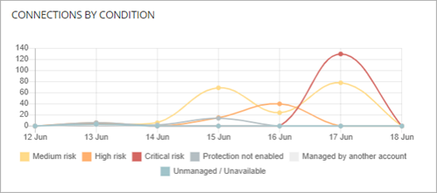
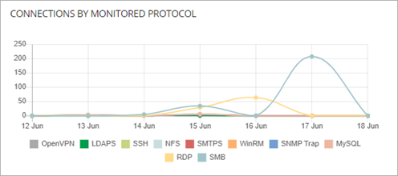
Endpoint Access Enforcement Dashboard
On the Endpoint Access Enforcement dashboard, you can review:
  Connection Map
  Top 5 Computers Reporting High-Risk Outbound Connections
  Top 5 Computers Reporting High-Risk Inbound Connections
  Connections by Condition
  Connections by Monitored Protocol

Slide 6
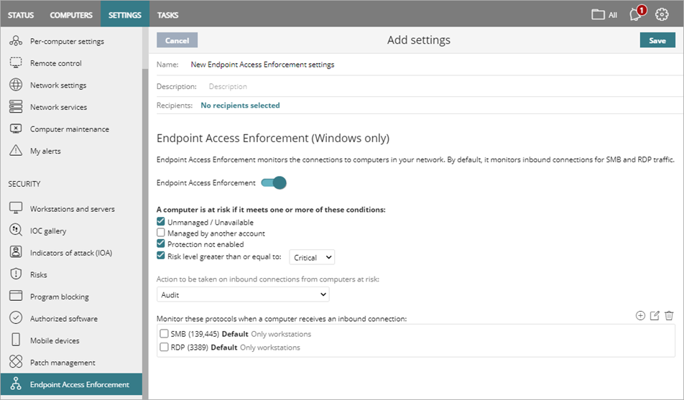
Endpoint Access Enforcement Settings
In an Endpoint Access Enforcement settings profile, you can:
  Specify the conditions for a computer at risk
  Select an action to take for inbound connections from computers at risk:
    Audit
    Block (Advanced EPDR only)
  Specify the protocols to monitor for inbound connections

Slide 7
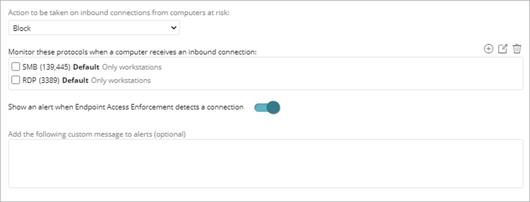
Endpoint Access Enforcement Settings
  With Block mode (Advanced EPDR only), you can show a local alert on the protected computer when Endpoint Access Enforcement detects a connection from a computer at risk and include a custom message

Slide 8
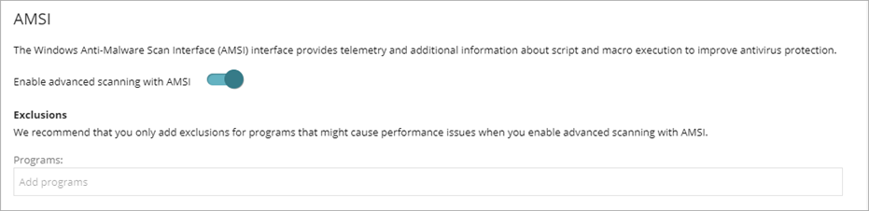
Advanced Scanning with AMSI
The Windows Anti-Malware Scan Interface (AMSI) provides telemetry and additional information about script and macro execution to improve antivirus protection for Windows computers
  In a Workstations and Servers settings profile, advanced scanning with AMSI is enabled by default
  If you experience performance issues, you can add exclusions for problematic programs or disable advanced scanning with AMSI

Slide 9
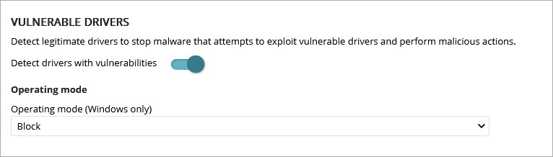
Block Vulnerable Drivers
In the Advanced Protection section of a Workstations and Servers security settings profile, you can now enable WatchGuard Endpoint Security to identify legitimate drivers that have vulnerabilities that malware could exploit

Slide 10
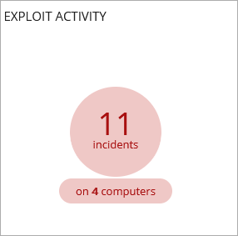
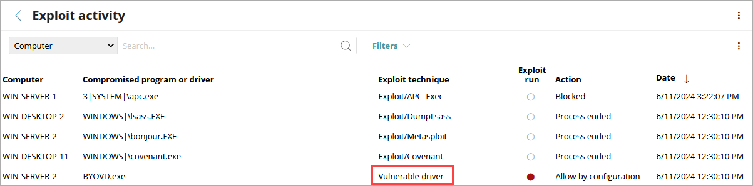
Block Vulnerable Drivers
When identified, these vulnerable drivers show in the Exploit Activity widget on the Security dashboard
To see driver details, select the affected computer in the Exploit Activity list

Slide 11
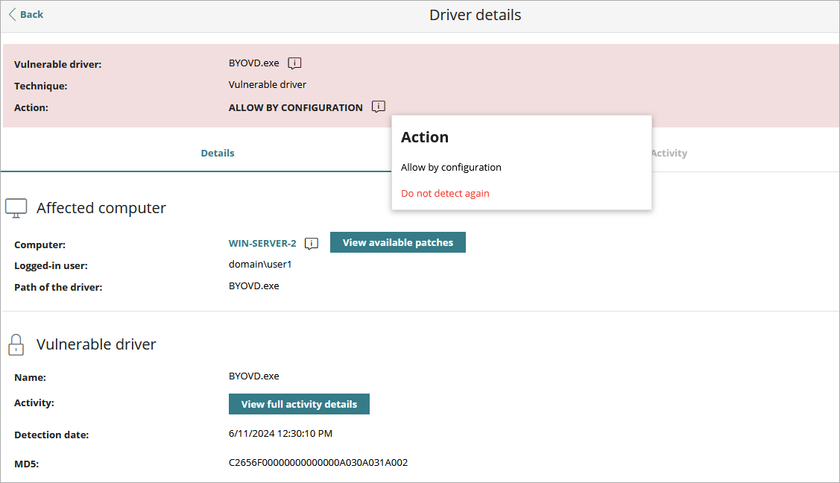
Block Vulnerable Drivers
You can allow the blocked driver to run or stop allowing the driver when it was previously allowed

Slide 12
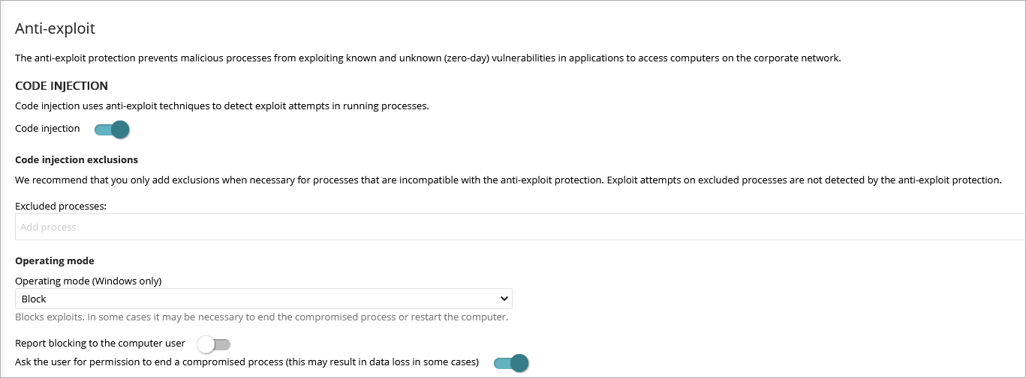
Enable Anti-Exploit Protection
In the Advanced Protection section of the Workstations and Servers security settings profile, you now enable anti-exploit protection with the Code Injection toggle

Slide 13
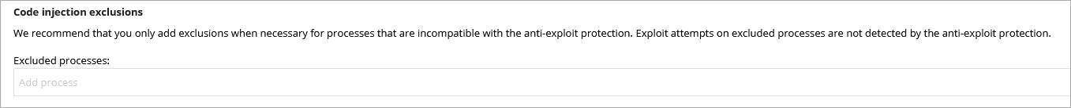
Code Injection Exclusions
Anti-exploit protection detects advanced mechanisms that inject code in running processes
You can exclude processes that are incompatible with anti-exploit protection
  Anti-exploit protection does not detect code injections on excluded processes, although it continues to protect all other running processes
To exclude a process, type its file name in the Excluded Processes text box and press Enter

Slide 14
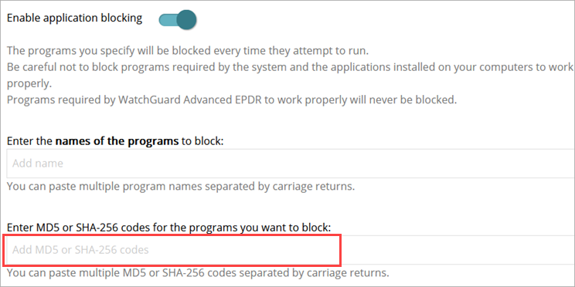
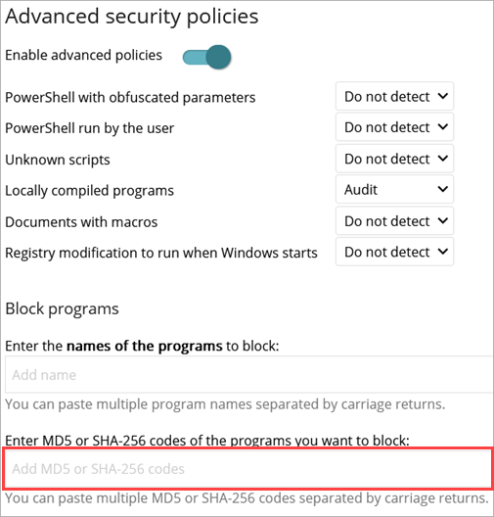
SHA-256 Support
You can now specify the SHA-256 hash value of a program you want to block in these security settings profiles for Windows computers:
  Workstations and Servers
  Program Blocking

Slide 15
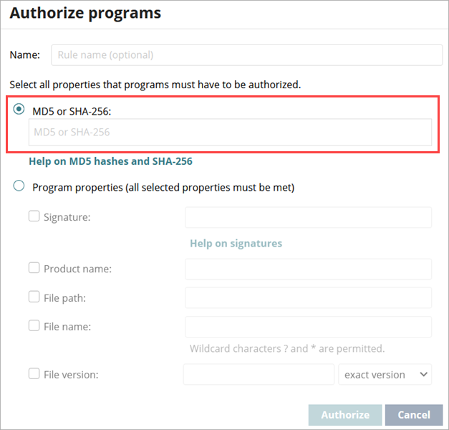
SHA-256 Support for Authorized Programs
You can now specify the SHA-256 hash value of the programs that must be authorized on Windows computers

Slide 16
SHA-256 Support
In the Security dashboard, you can monitor and filter the results based on the SHA-256 hash values of the files in these tiles:
  Programs Blocked by the Administrator
  Detected Items Allowed by the Administrator
  Detections by Advanced Security Policies

Slide 17
Risk Exclusion Management
WatchGuard Endpoint Security assigns a specific risk level to each risk detected on computers
On the Manage Exclusion Impact page, you can now control whether folder-level, file, or file extension exclusions impact the overall security risk status for a computer
From the Settings > Risks page, next to Folder, File, and Extension exclusions, click Manage Exclusion Impact

Slide 18
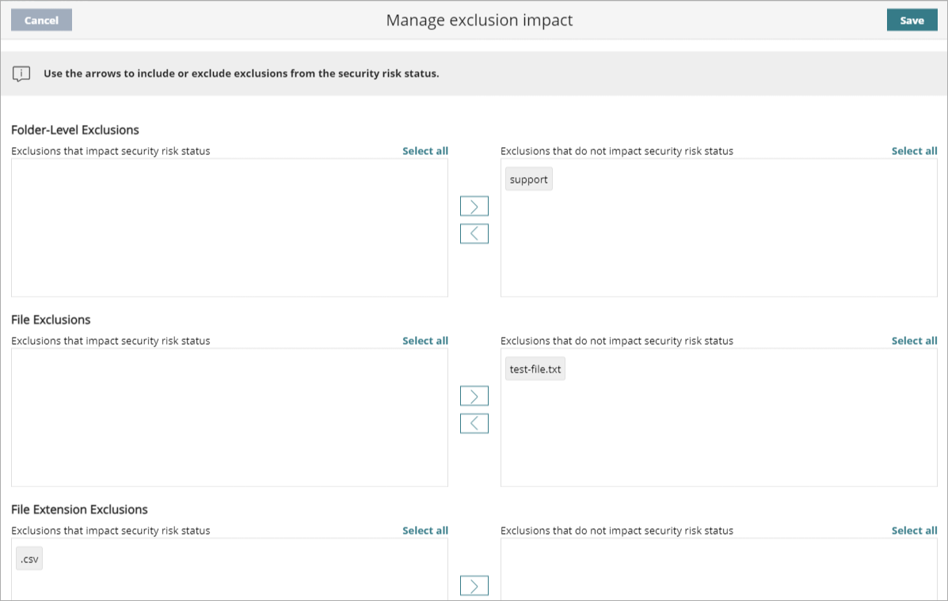
Manage Exclusion Impact
Use the arrows on the page to specify the folders, files, and file extensions that impact or do not impact security risk status

Slide 19
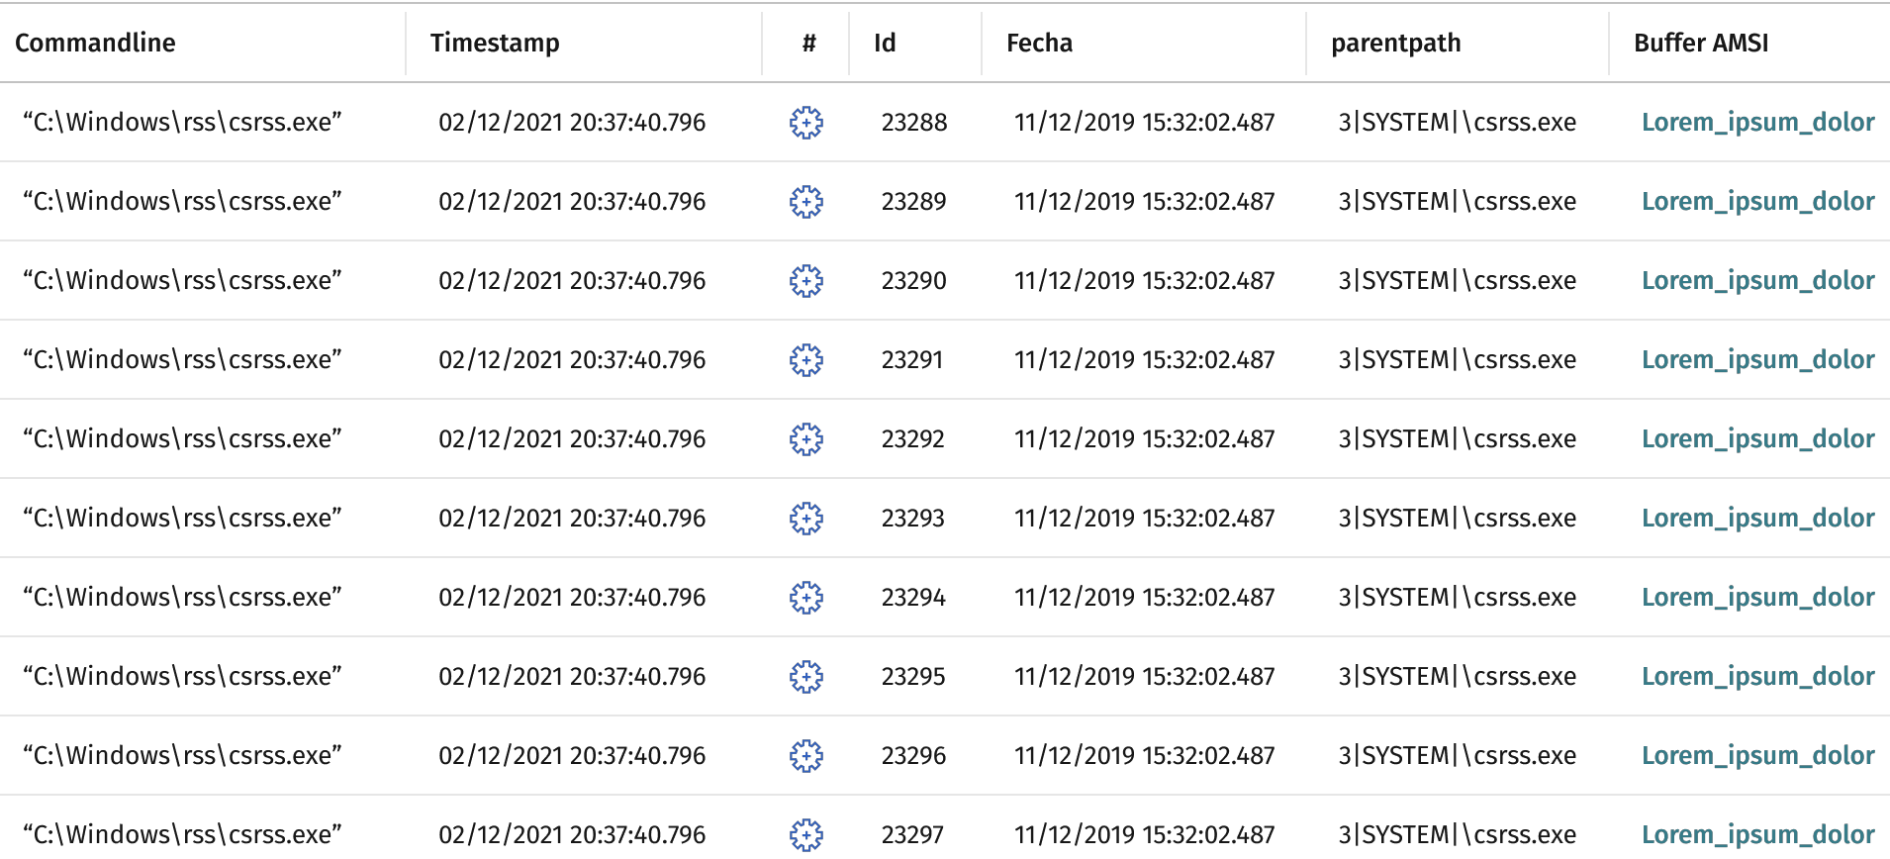
Verbose Mode
Verbose mode enables computers to generate extended telemetry over a limited time interval
  You can analyze this information to troubleshoot an Indicator of Attack (IOA) event
  Useful for security operators that want to simulate attacks in a POC under the MITRE standard

Slide 20
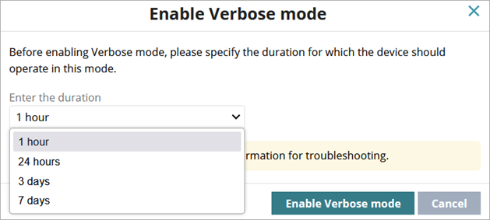
Verbose Mode
You can enable the Verbose mode only on Windows computers in Audit mode
  You can configure a maximum of 20 devices in Verbose mode simultaneously
You can configure Verbose mode for these durations:
  1 hour
  24 hours
  3 days
  7 days

Slide 21
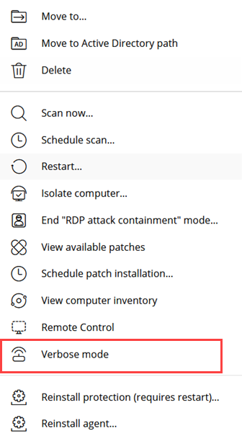
Verbose Mode
To enable Verbose mode:
  From the list of computers, click the options menu for a Windows computer and select Verbose Mode

Slide 22
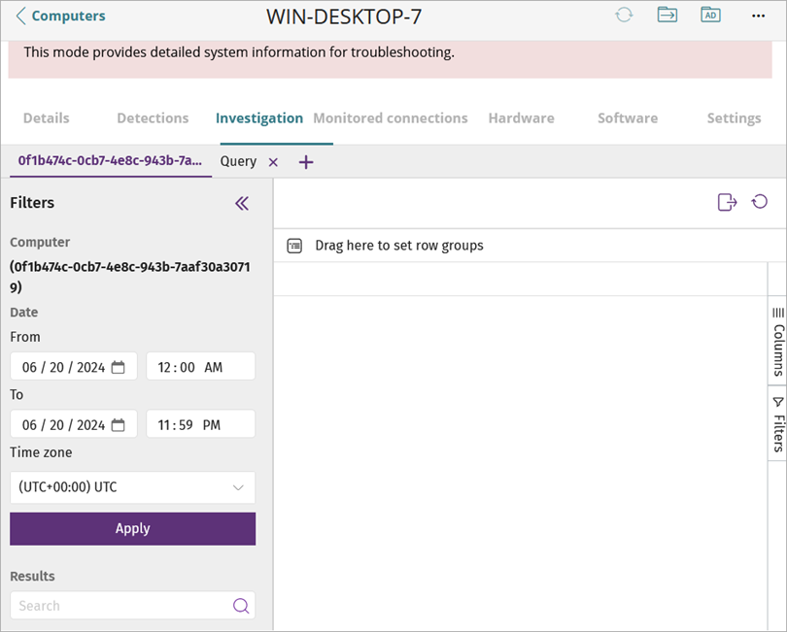
Investigation Tab
A new Investigation tab is available from the computer details page
On this tab, you can review the telemetry collected for a computer

Slide 23
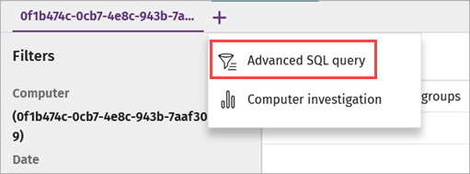
Investigation Tab
You can use Advanced SQL queries to filter the telemetry data

Slide 24
Network Access Enforcement for Android Devices
The Android mobile security app now supports network access enforcement
With network access enforcement, Android devices that try to connect to a Firebox VPN or an access point Wi-Fi network are required to meet specified security requirements
  For more information, go to Configure Network Access Enforcement in WatchGuard Endpoint Security in Help Center

Slide 25
Linux – Report a Problem Feature
The Report a Problem feature automatically sends all the information required for diagnosis to Customer Support
On the Computers page, you can now select Report a problem for Linux devices
This feature is only available in Adaptive Defense 360, Adaptive Defense, and Cytomic products

Slide 26
Windows Server 2025 Support
WatchGuard Endpoint Security and AD360 now support Windows Server 2025

Slide 27
Advanced EPDR – Mac and Linux Specific Updates
Advanced EPDR for Mac and Linux endpoints now supports these features:
  Local alerts — You can now disable, enable, and customize local alerts on Mac computers for malware, firewall, and device control alerts
    For more information, go to Configure Local Alerts in Help Center
  Remote control — You can remotely connect to Mac and Linux computers on your network from the Endpoint Security management UI or the ThreatSync management UI
    For more information, go to About the Remote Control Tool in Help Center
  Isolation — You can now isolate an at-risk Linux computer to block communication to and from the device
    For more information, go to Isolate a Computer in Help Center

Slide 28
Sequoia – Supported macOS Version
WatchGuard Endpoint Security now supports macOS 15 Sequoia

Slide 29
New Supported Linux Versions
WatchGuard Endpoint Security now supports these Linux distributions and versions:
  OpenSUSE 15.3, 15.4, 15.5, and 15.6
  SUSE 15 SP6
  Fedora 39 and 40
  Red Hat / Oracle / Rocky / Alma 8.9, 8.10, 9.3, and 9.4
  Ubuntu 23.10 and 24.04
  Mint 21.2, 21.3, and 22

Slide 30
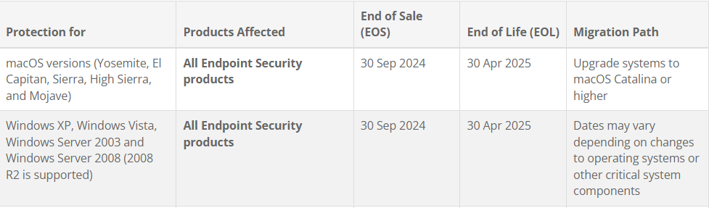
End of Sale and End of Life Products
As of 30 September 2024, these operating service versions have entered the End of Sale period for all Endpoint Security products:
You cannot add to the management UI or install the protection software on new computers that run these operating system versions
WatchGuard supports End of Sale products until the start of End of Life

Slide 31
End of Maintenance – Exchange Server Protection
As of 30 September 2024, Microsoft Exchange Server protection is no longer supported or maintained
The protection software will only be available for customers that currently use it until 1 January 2025

